Slide 1

Application Flow, Filters & Middleware
Application Fundamentals, Errors, Filters, Middleware
SoftUni Team
Technical Trainers
Software University
http://softuni.bg

Slide 2
Table of Contents
Application Flow
Application fundamentals
The Request Lifecycle
Error Handling
Middleware
Creating our own middleware
Filters
Creating our own filters

Slide 3
Have a Question?
sli.do #csharp-web

Slide 4

Application Flow

Slide 5


Application Fundamentals
Web Applications handle Requests and produce Responses
The whole process is naturally ordered in some kind of pipeline
In most cases, the process is extensible and modifiable
Web Applications have different deployment environments
The environments determine the behavior of the application
The environments may also affect the pipeline
Web Applications have initial configuration
Host, Security, Directories, Conventions etc.

Slide 6
MVC Request Lifecycle
Middleware
Routing
Controller Initialization
Request
Components on the HTTP Pipeline
Routing Middleware MVC Route Handler
Controller Action Invoker Controller Factory
Action Execution
View Engine
Result Execution
Response
Model Binding
Model Validation Action Filters Action Execution Action Filters Action Result
Find and Render the View
Result Filters Invoke Action Filters Result Filters
Other Action Result

Slide 7







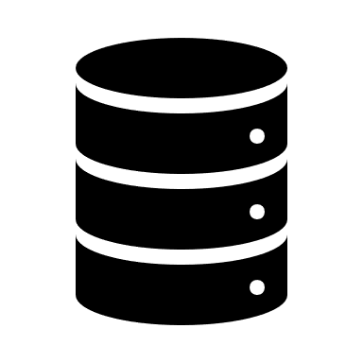

Controller Context
The Controller is one of the main components in the Request pipeline
Each Controller has its own ControllerContext
A set of useful properties containing data about the current Request
ControllerContext Properties:
ActionDescriptor
HttpContext (Request, Response)
ModelState
RouteData
ValidProviderFactories

Slide 8
Application Fundamentals
ASP.NET Core uses the Configure() method in the StartUp.cs to:
Configure the HTTP Request Pipeline
Define behavior for different environments
This is done using the IApplicationBuilder and IHostingEnvironment
public void Configure(IApplicationBuilder app, IHostingEnvironment env)
{
if (env.IsDevelopment()) { app.UseDeveloperExceptionPage(); }
else { app.UseExceptionHandler("/Error"); }
app.UseHttpsRedirection();
app.UseStaticFiles();
app.UseCookiePolicy();
app.UseMvcWithDefaultRoute();
}

Slide 9
Application Environments
Software Deployment is usually distributed into several environments
Multi-stage deployment is a MUST in Enterprise applications
A computer system (real or virtual) which runs your software
May include tasks which run on it (like Unit or End-to-End tests)
Most environment architectures use the following environments:
Dev – Where the program or component is developed
Test – Where the product (component) is tested & verified by developers
Stage – Where the customer tests if the product meets their expectations
Production – Where the product is made available to all users

Slide 10
ASP.NET Core Environments
ASP.NET Core configures app behavior based on runtime environment
The Framework supports 3 environments – Development, Staging and Production
ASP.NET Core reads the Environment variable – "ASPNETCORE_ENVIRONMENT"
Environment value is stored in IHostingEnvironment.EnvironmentName
The environment can be set to any value. The default environment is Production
public void Configure(IApplicationBuilder app, IHostingEnvironment env)
{
if(env.IsDevelopment()) //TODO: Do Development
if(env.IsStaging()) //TODO: Do Staging
if(env.IsProduction()) //TODO: Do Production
if(env.IsEnvironment("some_environment")) //TODO: Do Something ...
}

Slide 11


Application Configuration
App configuration in ASP.NET Core is based on key-value pairs
App configurations are specified in configuration providers
Configuration providers read data from configuration sources
Azure Key Vault, Command-line arguments
Custom providers (installed or created)
Directory files, Environment variables, etc.
One of the default sources is appsettings.json

Slide 12
Application Configuration
App configuration is read at app startup from the providers
Configuration properties are mapped in IConfiguration
IConfiguration is available in the app’s DI container
{
"Greeting": "Hello!",
"Config": {
"Secret": "Can’t touch this"
},
...
}
{
"Greeting": "Hello!",
"Config": {
"Secret": "Can’t touch this"
},
...
}
appsettings.json
appsettings.json
public class HomeController : Controller
{
private readonly IConfiguration config;
public HomeController(IConfiguration config)
{
this.config = config;
}
public IActionResult Config()
{
return Content(this.config["Greeting"]); // Hello!
}
}
public class HomeController : Controller
{
private readonly IConfiguration config;
public HomeController(IConfiguration config)
{
this.config = config;
}
public IActionResult Config()
{
return Content(this.config["Config:Secret"]); // Can’t touch this!
}
}
HomeController.cs
HomeController.cs

Slide 13

Application Services Configuration
Configuration options, by convention, are set in ConfigureServices()
Called before the Configure() method, by the WebHost
Typical pattern is Add{Service} and then services.Configure(Service)
Adding services to the service container:
Makes them available within the app
Resolved via Dependency Injection
Makes them available within the Configure() method
Resolved via IApplicationBuilder.ApplicationServices

Slide 14

Application Services Configuration
Services can be configured for Dependency Injection differently
public void ConfigureServices(IServiceCollection services)
{
// Transient objects are always different
// A new instance is provided to every controller and service
services.AddTransient<DataService>();
// Scoped objects are the same within a request
// They are different across different requests
services.AddScoped(typeof(DataService));
// Singleton objects are the same for every object and request.
services.AddSingleton<DataService>(); ...
}

Slide 15
!
Error Handling
Diagnostics & Custom Error Handlers

Slide 16

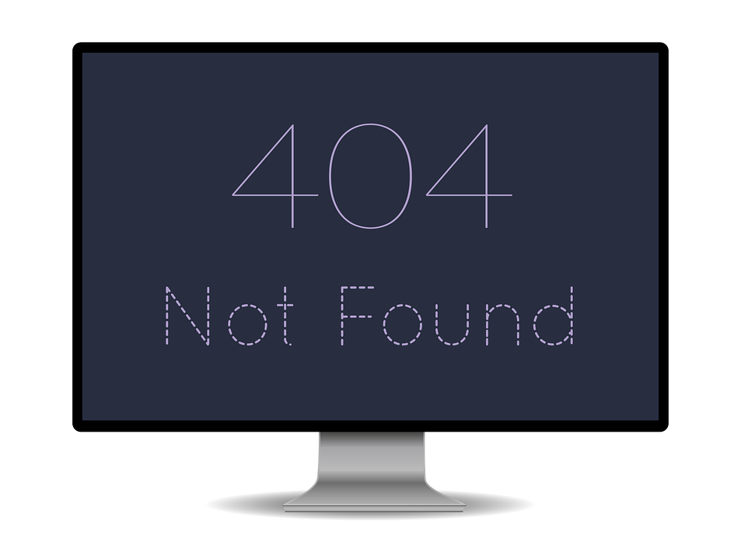

Error Handling
There are several ways to configure Error handling in ASP.NET Core
Developer Exception Page
Exception Handler
Status Code Pages
ASP.NET Core MVC apps have additional options for handling errors
Exception Filters
Model Validation (ModelState)

Slide 17
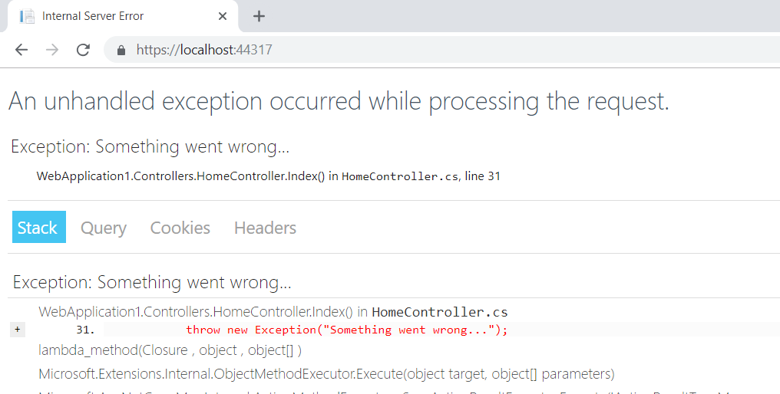
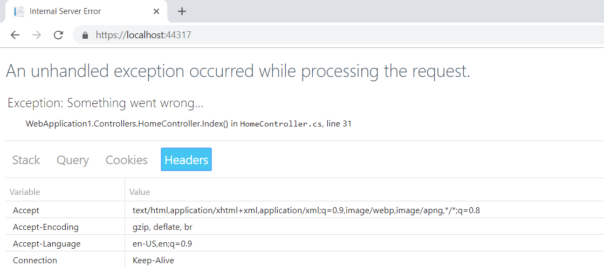
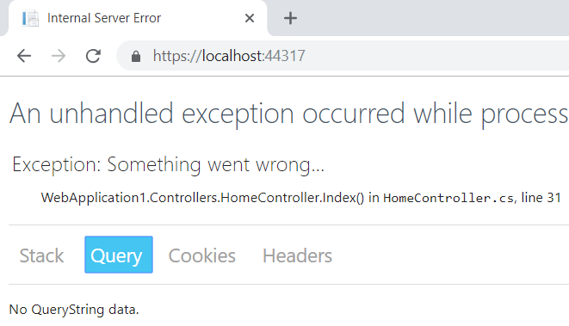
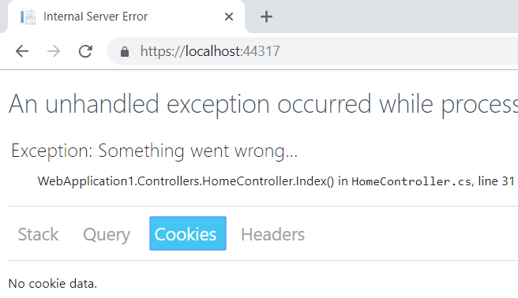
Error Handling (Developer Exception Page)

Slide 18
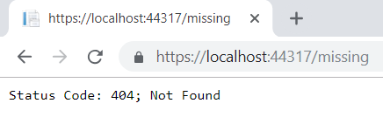
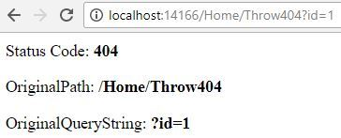
Error Handling (Status Code Pages)
ASP.NET Core apps do not provide rich status code pages
To provide such, you have to use the Status Code Pages Middleware
app.UseStatusCodePages()
The Middleware can easily be customized
Supports several extension methods. For example:
app.UseStatusCodePagesWithRedirects(…)
app.UseStatusCodePagesWithReExecute(…)

Slide 19
Error Handling (Custom Error Handler)
Configuring a custom exception page is done by using the ExceptionHandlerMiddleware
You can then implement a handler for that route
It can be a Controller Action, a Razor Page or other handler
...
public void Configure(IApplicationBuilder app, IHostingEnvironment env)
{
app.UseExceptionHandler("/Error");
...
}

Slide 20

Middleware

Slide 21
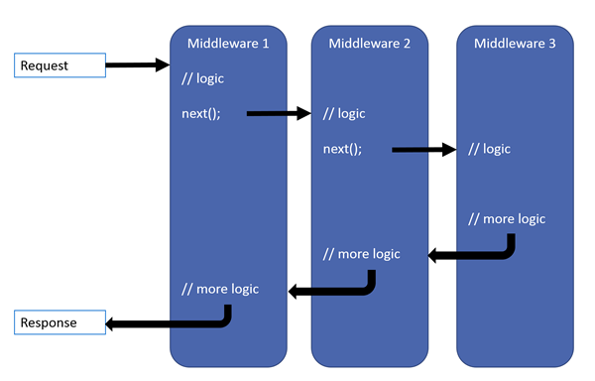
Middleware
A software, assembled into an app pipeline. Each component:
Handles Requests and Responses
Chooses whether to pass the Request to the next component in the pipeline
May perform work before or after the next component in the pipeline is invoked
In ASP.NET Core, Request Delegates build the Request Pipeline.

Slide 22
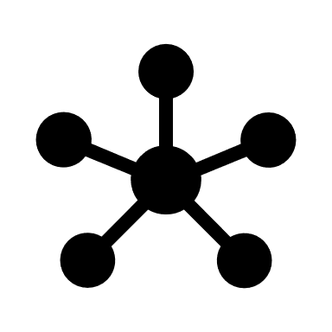
Request Delegates
Request Delegates handle each HTTP Request
Are configured using the extension methods Run(), Map() and Use()
Request Delegates (also called middleware components) can be:
Specified in-line as an anonymous method (called in-line middleware)
Defined in a reusable class
Each middleware component is responsible for:
Invoking the next component in the pipeline
Or short-circuiting the pipeline

Slide 23
Request Delegates
The Use() method is used to chain multiple delegates together
It can short-circuit the pipeline (if it does not invoke next())
The first Run() delegate terminates the pipeline
Run() is a convention
Some middleware expose Run{Middleware} methods
These methods run at the end of the pipeline
The Map() method is used to branch the pipeline
The request pipeline is branched – based on the given request path

Slide 24
Creating your own Middleware (inline)
The ASP.NET Core Request Pipeline consists of a sequence of Request Delegates, called one after another
Custom Request Delegates are created using the IApplicationBuilder
public void Configure(IApplicationBuilder app, IHostingEnvironment env)
{
app.Use(async (context, next) =>
{
// Do work that doesn't write to the Response.
await next();
// Do logging or other work that doesn't write to the Response.
});
//Other code below... ...
}

Slide 25

Creating your own Middleware (class)
Request delegates can also be defined as classes
The next delegate in the pipeline
public class CustomMiddleware
{
private readonly RequestDelegate next;
public CustomMiddleware(RequestDelegate next)
{
this.next = next;
}
// IMyService is injected into InvokeAsync
public async Task InvokeAsync(HttpContext httpContext, IMyService svc)
{
svc.MyProperty = 1000;
await this.next(httpContext);
}
}
Third-party dependencies are injected through DI

Slide 26
Creating your own Middleware (class) (2)
The custom Middleware class needs to be included into the pipeline
public static class CustomMiddlewareExtensions
{
public static IApplicationBuilder UseCustom(this IApplicationBuilder builder)
{
return builder.UseMiddleware<CustomMiddleware>();
}
}
public class Startup
{
public void Configure(IApplicationBuilder app)
{
app.UseCustom();
...
}
}

Slide 27

Built-in Middleware
Some built-in middleware in ASP.NET Core are:
Middleware | Import
Authentication | app.UseAuthentication()
Cookie Policy | app.UseCookiePolicy()
CORS | app.UseCors()
Diagnostics | app.UseDevelopmentExceptionPage() app.UseExceptionHandler(…) app.UseStatusCodePages()
HTTPS Redirection | app.UseHttpsRedirection()
HSTS | app.UseHsts()
MVC | app.UseMvc()
Static Files | app.UseStaticFiles()

Slide 28


Built-in Middleware (2)
Many more are available on NuGet
Middleware | Import
Response Caching | app.UseResponseCaching()
Response Compression | app.UseResponseCompression()
Request Localization | app.UseRequestLocalization(…)
Routing | app.UseRouter(…)
Session | app.UseSession()
URL Rewriting | app.UseRewriter(…)
WebSockets | app.UseWebSockets(…)
Others | app.UseWelcomePage()

Slide 29

Filters

Slide 30
Filters
Filters allow you to run code before or after specific stages in the Request Processing Pipeline
Filters are similar but NOT the same as Middleware
Middleware operate on the level of ASP.NET Core
Filters operate only on the level of MVC
Request
Other Middleware
Routing Middle
ware
Action Selection
MVC Action Invocation Pipeline (Filter Pipeline)

Slide 31
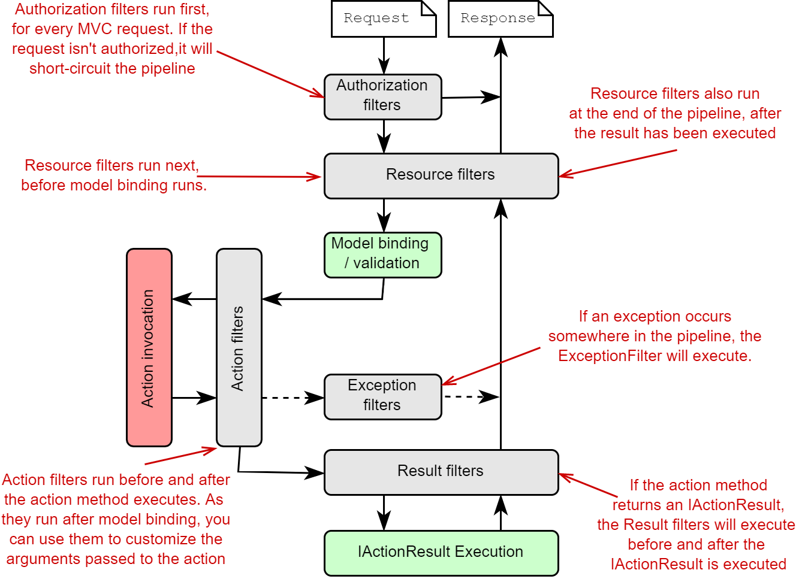
Filters

Slide 32
Filters
There are several types of Filters
Each is executed on a different stage of the Filter Pipeline
There are Authorization, Resource, Action, Exception and Result Filters
Filter | Description
Authorization | Run first. Determine if the Client is authorized to access the Requested functionality
Resource | Run immediately after Authorization. Can run code before and after the rest of the pipeline
Action | Run immediately before and after an individual Action Method is invoked.
Exception | Used to apply global policies for unhandled errors that occur.
Result | Run immediately before and after execution of individual Action Results.

Slide 33
Implementing Custom Filters
ASP.NET Core MVC Filters can be both synchronous and asynchronous
Synchronous
Asynchronous
public class SampleActionFilter : IActionFilter
{
public void OnActionExecuting( ActionExecutingContext context)
{
// DO before the action executes
}
public void OnActionExecuted( ActionExecutedContext context)
{
// DO after the action executes
}
}
public class SampleAsyncActionFilter : IAsyncActionFilter
{
public async Task OnActionExecutionAsync(
ActionExecutingContext context,
ActionExecutionDelegate next)
{
// DO before the action executes
var resultContext = await next();
// DO after the action executes
// resultContext.Result will be set
}
}

Slide 34
Adding Filters to the Pipeline (Global)
Filters are added globally in the MvcOption.Services
Will be applied to all Controllers and Actions
public void ConfigureServices(IServiceCollection services)
{
services.AddMvc(options => {
options.Filters.Add(new SimpleActionFilter()); // instant
options.Filters.Add(typeof(SimpleActionFilter)); // by type
...
});
...
}
public void Configure(IApplicationBuilder app, IHostingEnvironment env)
{
...
}

Slide 35
Filter Attributes
ASP.NET Core also includes built-in attribute-based Filters
public class AddHeaderAttribute : ResultFilterAttribute
{
private readonly string name;
private readonly string value;
public AddHeaderAttribute(string name, string value)
{
this.name = name;
this.value = value;
}
public override void OnResultExecuting(ResultExecutingContext context)
{
context.HttpContext.Response.Headers.Add(this.name, new string[] { this.value });
base.OnResultExecuting(context);
}
}

Slide 36
Filter Attributes
Attributes allow Filters to accept arguments
This particular Filter will attach the given Header and its value to every Result in the Controller
[AddHeader("Author", "Steve Smith @ardalis")]
public class SampleController : Controller
{
public IActionResult Index()
{
return Content("Examine the headers using developer tools.");
}
public IActionResult Test() {
return Content("Header will be present here too.");
}
}

Slide 37
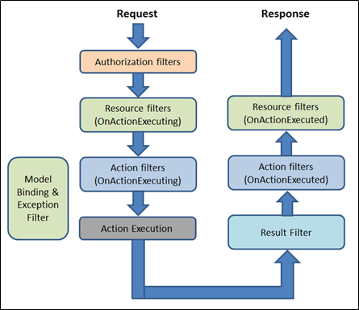
Filter Attributes
Several of the Filter interfaces have corresponding Attributes
These can be used as base classes for custom implementation
Filter Attributes:
ActionFilterAttribute
ExceptionFilterAttribute
ResultFilterAttribute
FormatFilterAttribute
ServiceFilterAttribute
TypeFilterAttribute

Slide 38
Filter Dependency Injection
Filters that are implemented as Attributes:
Are added directly to Controller classes or Action methods
Cannot have constructor dependencies provided by DI
Parameters must be supplied where the attributes are applied
This is a limitation of how filters attributes work
There are several approaches to include DI in Filter Attributes
ServiceFilterAttribute
TypeFilterAttribute

Slide 39
Filter Dependency Injection
Service filter implementation types are registered in DI
ServiceFilterAttribute retrieves an instance of the filter from DI
Used only for Filters that are registered as Services
TypeFilterAttribute is similar to ServiceFilterAttribute
The type is not resolved directly from the DI container
Type is instantiated using ObjectFactory.
There are ways to control the reusability of the instances
There is no guarantee that a single instance will be created

Slide 40
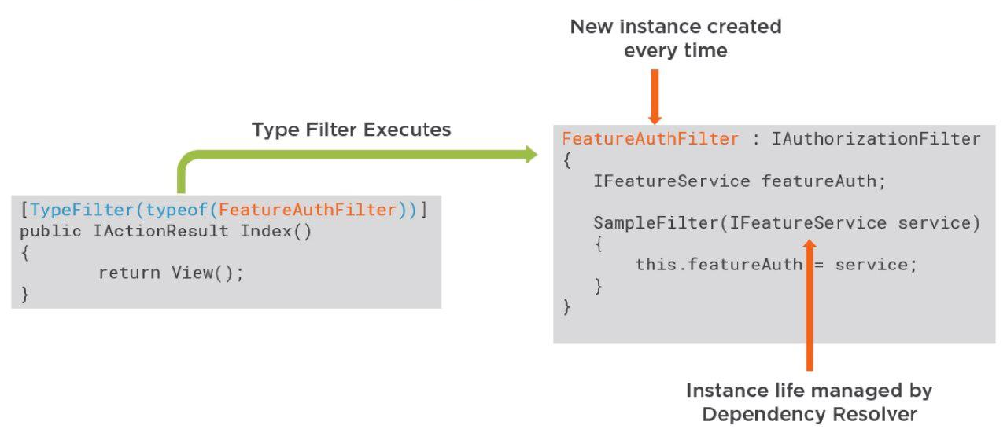
Type Filter

Slide 41
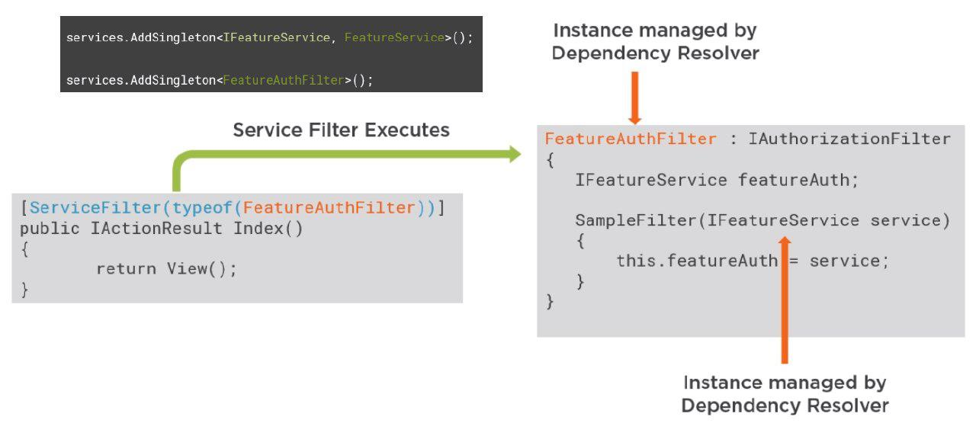
Service Filter

Slide 42

Summary
Application Flow
Application Environments
Request Lifecycle
Error Handling
Middleware
Filters
…
…
…

Slide 43
https://softuni.bg/trainings/courses

Slide 44












SoftUni Diamond Partners

Slide 45




SoftUni Organizational Partners

Slide 46




Trainings @ Software University (SoftUni)
Software University – High-Quality Education and Employment Opportunities
softuni.bg
Software University Foundation
http://softuni.foundation/
Software University @ Facebook
facebook.com/SoftwareUniversity
Software University Forums
forum.softuni.bg

Slide 47

License
This course (slides, examples, demos, videos, homework, etc.) is licensed under the "Creative Commons Attribution-NonCommercial-ShareAlike 4.0 International" license

